Slide 1

Bright TV Audience Intelligence Report
Subscriber Profiling, Spatial distribution and strategic growth vectors

Slide 2

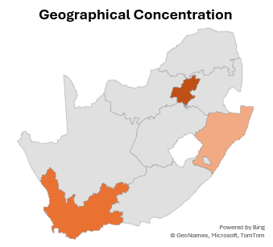
Executive Summary: The macro truths
The Data Hygiene Challenge
The Urban Millennial Core.
Viewership is heavily consolidated in the 25-45 age bracket, characterised by high social media connectivity.
The Big Three.
Gauteng, Western Cape, and KwaZulu-Natal absolutely dominate the verified subscriber footprint.
The Ghost Viewer Anomaly
A massive segment of registered emails lacks associated age, gender and friction for monetization.

Slide 3
The Generational Divide
The Engine: Ages 25-35 from the steepest engagement curve.
Bright TV’s heartbeat is the 25-45 demographic. This generational concentration provides a highly addressable target for lifestyle and tech-forward ad placements.

Slide 4
The Diversity of viewership
A highly diverse, multi-cultural footprint. Marketing vectors must reflect this broad South African reality rather than defaulting to monolithic messaging.

Slide 5
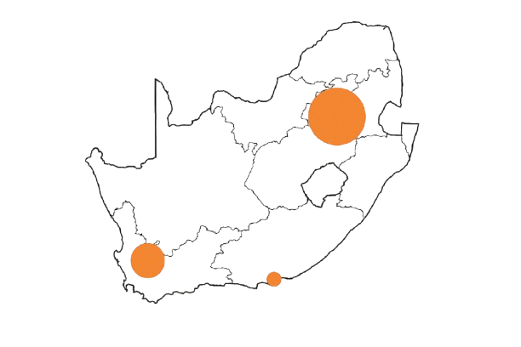
Geographic Density: The Core Markets
Gauteng
The Anchor Hub, Massive density.
Western Cape
The Coastal Stronghold
KwaZulu-Natal
The Eastern Pillar
Current penetration heavily mirrors South Africa’s primary economic and urban corridors.

Slide 6
Whitespace Expansion Matrix
Growth Potential
 | Current Penetration (User Volume)
Limpopo
Mpumalanga
Free State
Northen Cape
Mpumalanga
Northen Cape
While Gauteng provides stability, the next aggressive subscriber acquisition campaign should target untapped regional potential of Limpopo. Free State, and Mpumalanga

Slide 7
Diagnostic Matrix: Known vs. Unknown
 | Fully Profiled Viewer | Ghost User
Marketing Addressability | High (Hyper-local ad targeting) | Zero (Cannot target by region or age)
Estimated Lifetime Value (LTV) | Optimized | Depressed (Inability to serve premium ads)
Churn Risk | Predictable via modelling | High (Recommendations lack geo-context)
Ghost users represent trapped revenue. Fixing data hygiene is a direct path to increasing Average Revenue Per User (ARPU)

Slide 8
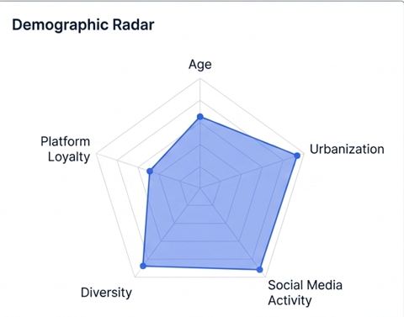
Audience Persona 1
Profile Card.
The Regional Gen-Xer
40-55 Years Old
White, Indian & Coloured presence
Western Cape & Eastern Cape
The Urban Millennial is the platforms' centre of gravity. They are deeply connected, highly urban, and represent the ideal target for rapid social media acquisition

Slide 9
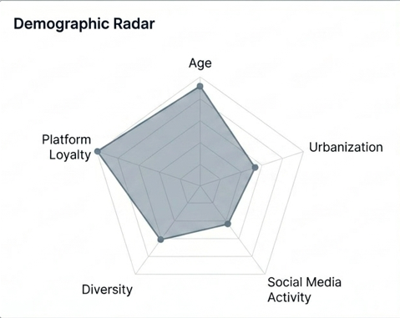
Audience Persona 2
Profile Card.
The Regional Gen-Xer
40-55 Years Old
White, Indian & Coloured presence
Western Cape & Eastern Cape
The Regional Gen-Xer provides stability. This older, regionally distributed cohort represents high retention potential outside the primary Gauteng cluster.

Slide 10
Cross-sectional Analysis: Age vs location
Sum of Subscriber_Count | Age_Groups
Province | Boomers (56+) | Gen X (41-55) | Gen Z (under 25) | Millennials (25-40)
Eastern Cape | 10 | 67 | 53 | 157
Free State | 1 | 34 | 35 | 86
Gauteng | 51 | 336 | 278 | 1039
Kwazulu Natal | 11 | 87 | 77 | 305
Limpopo | 5 | 37 | 82 | 244
Mpumalanga | 4 | 68 | 100 | 248
Null | Null | Null | Null | 1
North West | 6 | 32 | 27 | 96
Northern Cape | 6 | 5 | 17 | 58
Western Cape | 19 | 192 | 92 | 488
Total | 113 | 858 | 761 | 2722
Younger audience are fiercely concentrated in Gauteng, while older demographics are more evenly distributed across coastal provinces. Content acquisition must map these regional age skews.

Slide 11
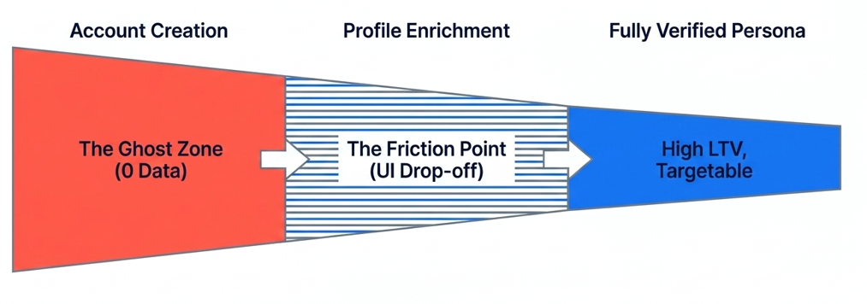
Synthesis: The Engagement Lifecycle
We do not have a ‘bad data’ problem; we have an incomplete UX journey. Ghost users are captive audience waiting for targeted UI nudges.

Slide 12



Strategic Imperative 1: Data Remediation
Introduce soft UI nudges to unlock localized channels
Fram data collection as a UX upgrade, not a form.
Reward profile completion with a premium feature or ad-free window
Transform ‘None’ into known coordinates by integrating progressive profiling directly into the streaming interface.

Slide 13
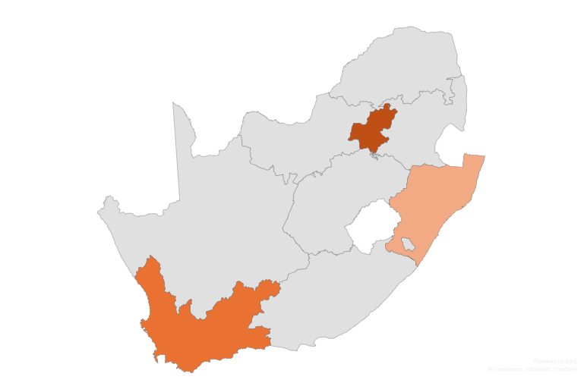
Strategic Imperative 2: Targeted Acquisition
A
Consolidate the Urban Millennial base in Gauteng
C
Aggressive Whitespace acquisition in Central/Northern province
B
Expand the Regional Gen-Xer footprint
Leverage our verified personas to capture the whitespace. Bright TV’s next phase of growth lies in converting regional dark spots into thriving hubs.

Slide 14
Thank you

